Slide 1
The Foolish Turtle

Slide 2
Fast
Slow

Slide 3
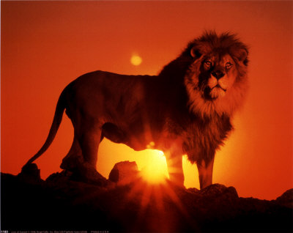
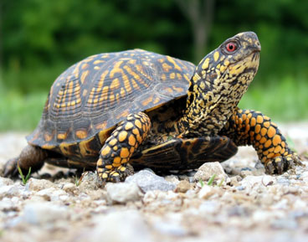
A Lion and a Turtle
Which one is faster?
The Lion moves faster!

Slide 4
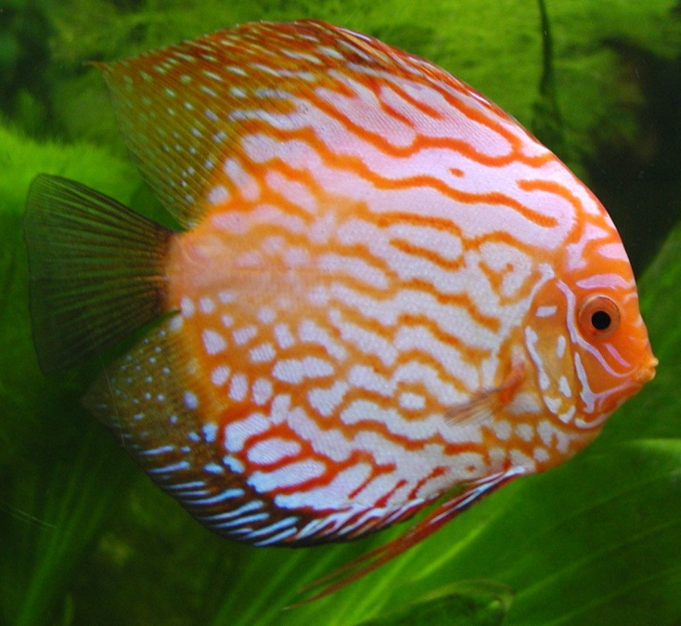
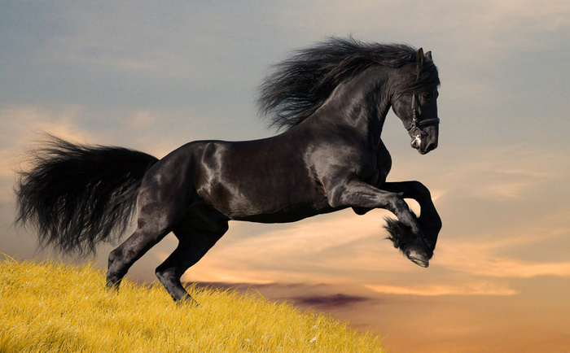
A Horse and a Fish
Which one moves slower?
The fish moves slower!

Slide 5
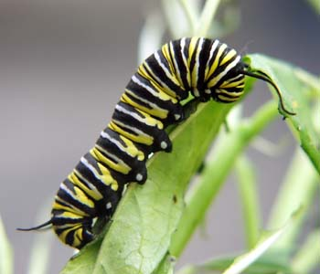
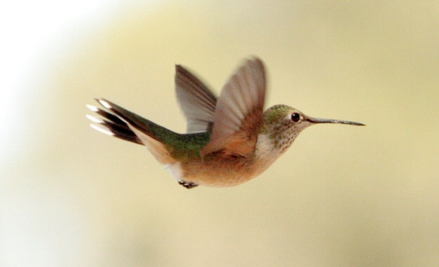
A Bird and a Catapiller
Which one moves faster?
The bird moves faster!

Slide 6
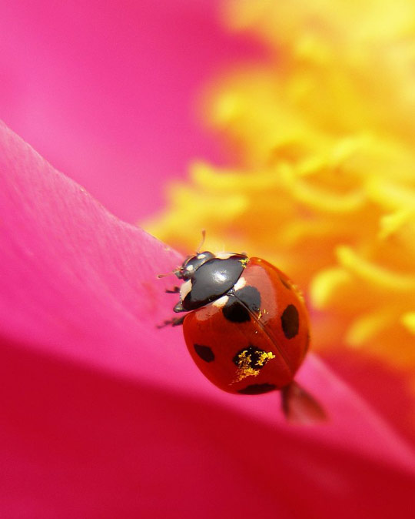
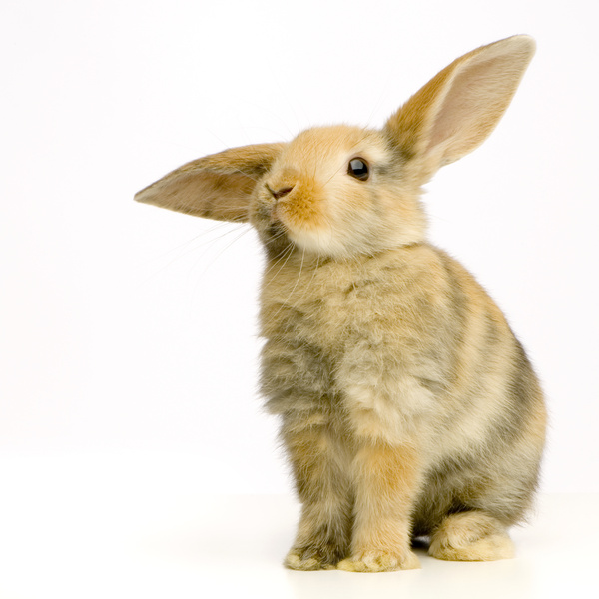
A Rabbit and a Ladybug
Which one moves faster?
The rabbit moves faster!

Slide 7
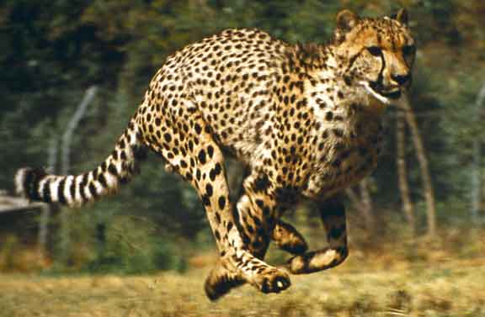
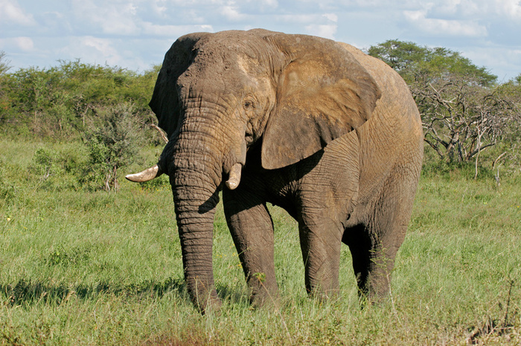
An Elephant and a Cheetah
Which one moves slower?
The elephant moves slower!

Slide 8
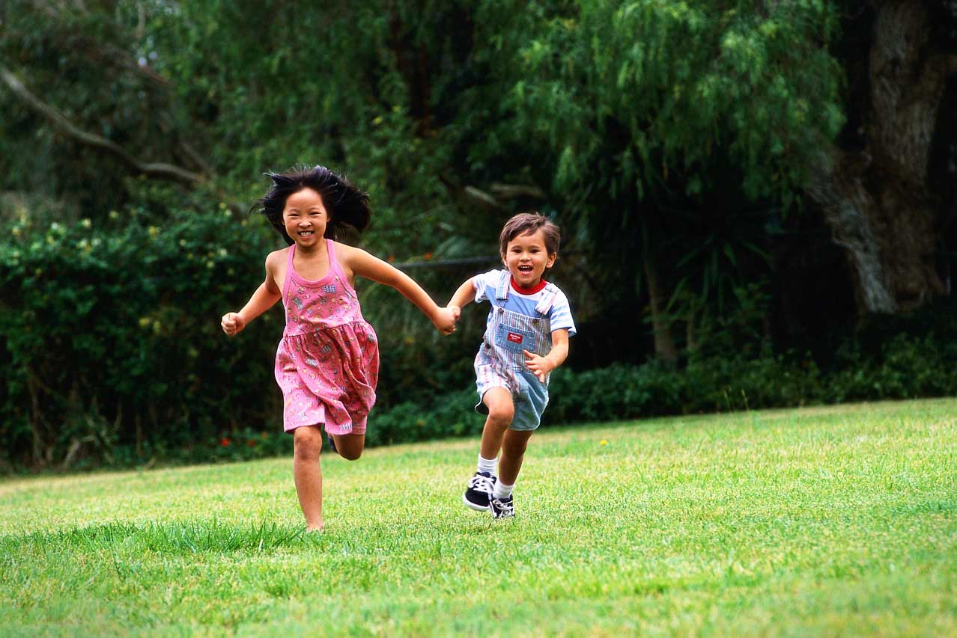
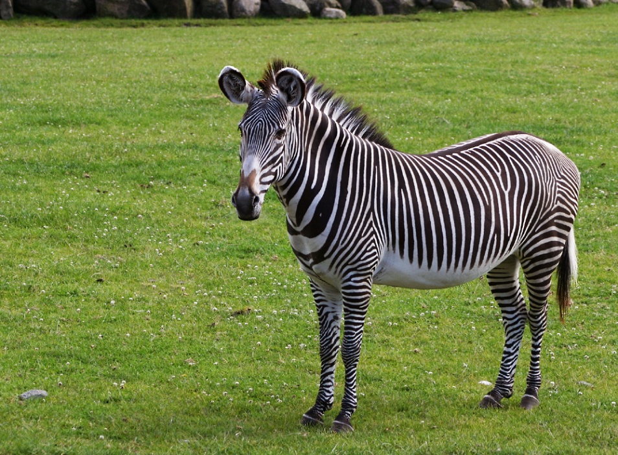
Two Children and a Zebra
Which one moves slower?
The two children move slower!

Slide 9
Fast
Slow

